Slide 1







E-COMMERCE PROJECT
Sales Analysis & Customer Experience Optimization
By, GANESH V

Slide 2
AGENDA
Problem Statement
Data Overview & Cleaning
Key Analysis & Insights
Loyalty Program Design
Dashboard Walkthrough
Recommendations

Slide 3
PROBLEM STATEMENT
You are working as a business analyst at Amazon, a company currently performing well. The stakeholders wish to maintain this level of performance and seek improvement. For this purpose, they want to devise new strategies. You are part of a team exploring new ways to benefit customers, such as offering more discounts and Prime membership perks. Could you suggest additional methods to identify and reward customers and enhance their shopping experience?

Slide 4
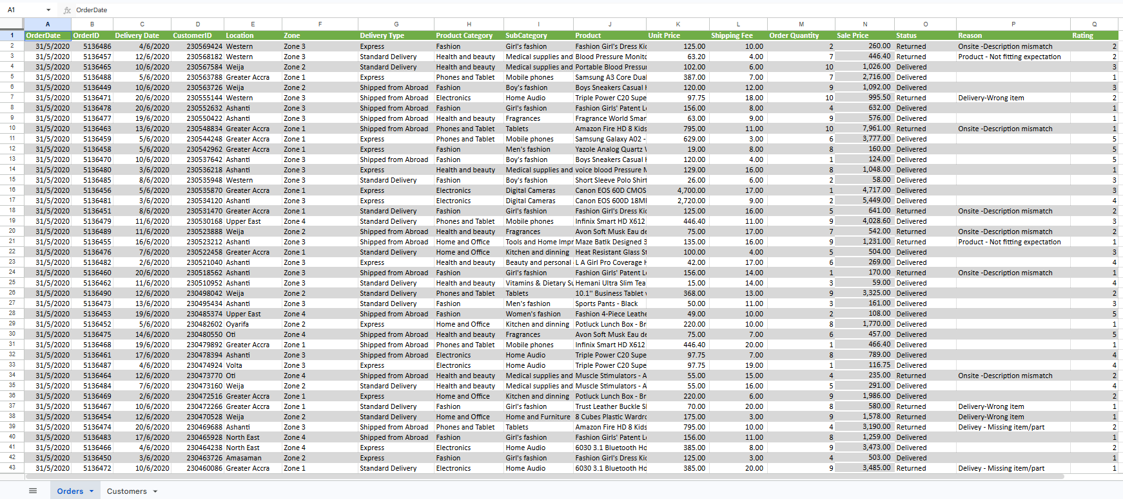
DATASET OVERVIEW

Slide 5
DATASET OVERVIEW
  2 tables:
Orders (113,000 rows, 17 columns)
Customers (113,000 rows, 3 columns)
  Time range from Year 2015 to 2020
  Key fields in Orders table: OrderDate, CustomerID, Product, Category, Price, Status, Rating
  Key fields in Customer table: CustomerID, Customer Age, Customer Gender

Slide 6
DATA CLEANING SUMMARY
  Table format, one row per issue:
Column | Issue | Action Taken
  Removal of 5 empty columns and 199 empty rows
  Included the corrupted Unit Price/Quantity rows removed, Reason nulls handled, Gender null fixed, data type corrections
  One line in "0.007% of data removed, rest cleaned in place, there is no data loss to core analysis"

Slide 7
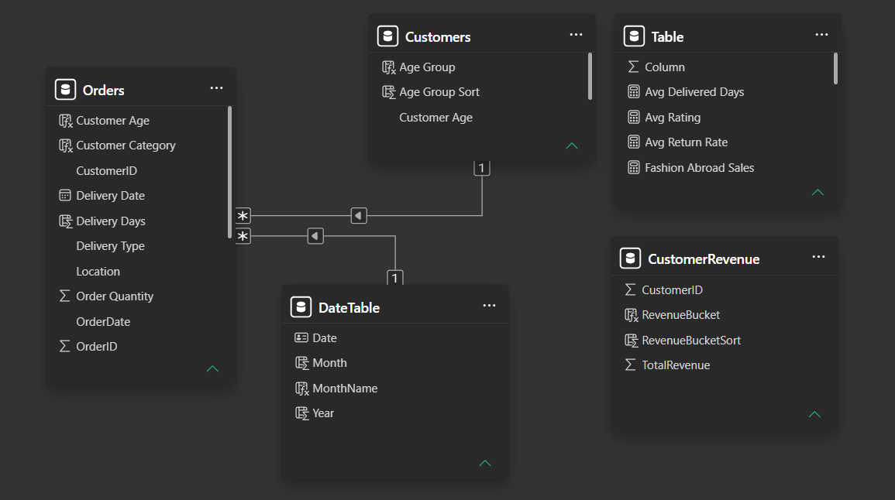
DATA MODEL
Star schema matters because it simplifies relationships, speeds up queries, and makes analytics easier to understand.

Slide 8
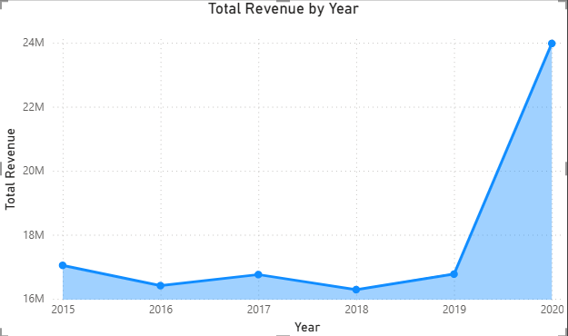
REVENUE & GROWTH OVERVIEW
  Total Revenue: 107.24M
  Total Orders: 113K
  Total Customers: 113K
  One key insight: growth was market-driven (2020 surge), not steady organic growth

Slide 9
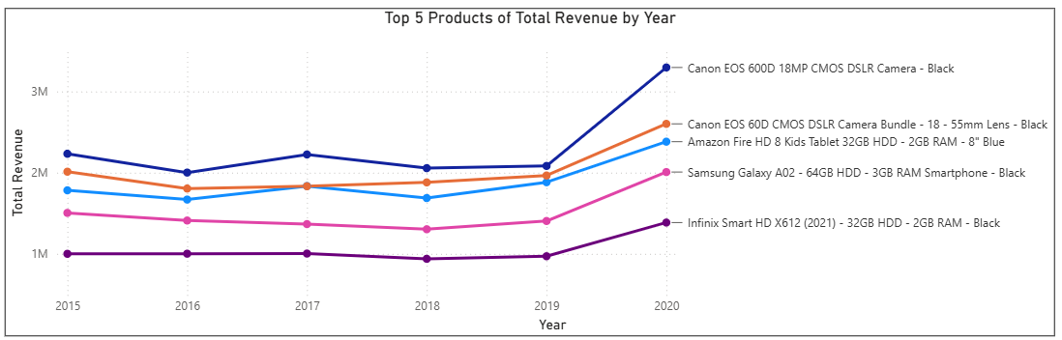
PRODUCT & CATEGORY PERFORMANCE
Top 5 "core" products that repeat every year
  Volume vs. Revenue inversion (Health & Beauty highest volume, Phones/Tablet highest revenue)
  Bottom 10 products and their ~3% revenue share

Slide 10
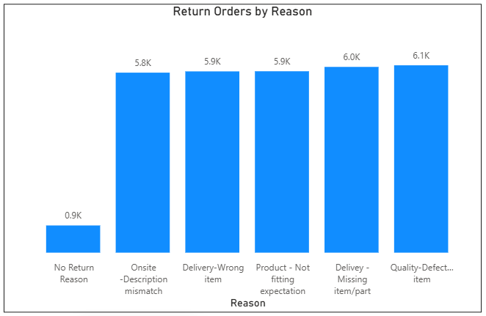
RETURNS & RATINGS ANALYSIS
  Return Rate: 27.01%
A key stat, large and centered
  Return reasons split,
Fulfillment errors (~39%)
Product/listing issues (~58%)
  Key finding: Rating is driven by return status, not delivery time, shipping type, or price

Slide 11
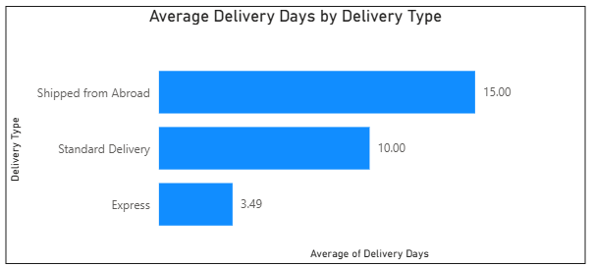
DELIVERY & LOGISTICS INSIGHTS
Delivery Type drives wait time as,
Express 3.5 days
Standard delivery 10 days
Abroad 15 days
Where, Category does not
  Shipping Fee has no relationship to category, price, or delivery type

Slide 12
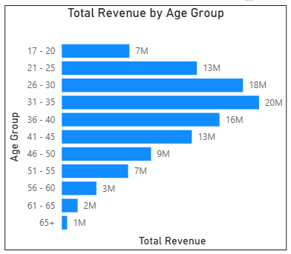
CUSTOMER & REVENUE CONCENTRATION
  18.6% of customers generate 67% of revenue
  Age 26-45 drives ~62% of revenue
  One key limitation to state honestly, every customer has exactly 1 order no repeat-purchase data available

Slide 13
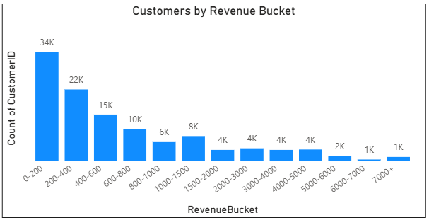
PROPOSED LOYALTY PROGRAM
Tier breakdown,
Platinum for 5000 <
Gold for 1500 - 5000
Silver for 600 - 1500
Bronze for <600
  34K customers fits in the 0-200 bucket, while only ~1K reach ₹7,000+.

Slide 14
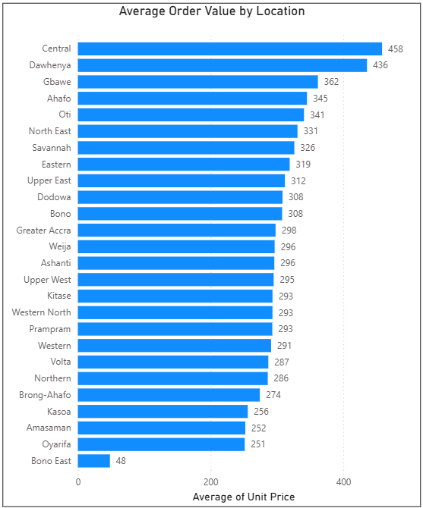
LOCATION BASED ANALYSIS
  Average Order Value ranges dramatically across Ghana's 26 locations, from ₹458 in Central down to just ₹48 in Bono East,
  Nearly a 10x gap between the highest and lowest performing regions.

Slide 15
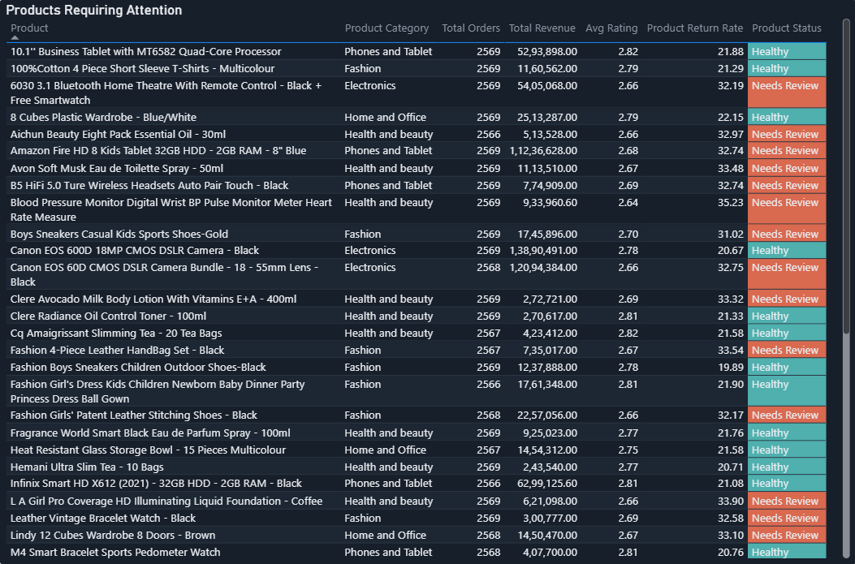
DISCOUNT STRATEGY
  The products with status “Healthy” are capable of providing the discounts
  The products with status “Needs Review”, because their Return Rate exceeds the Avg Return Rate

Slide 16
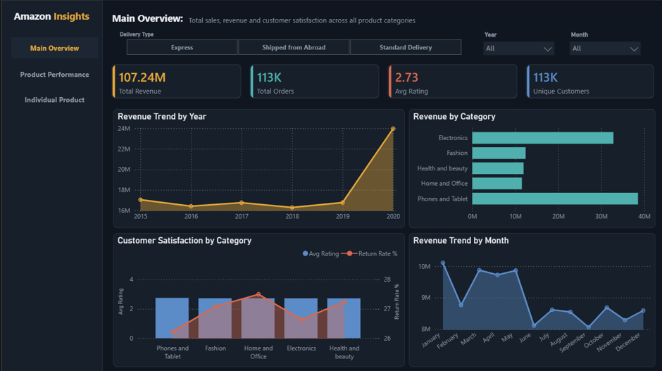
DASHBOARD WALKTHROUGH

Slide 17
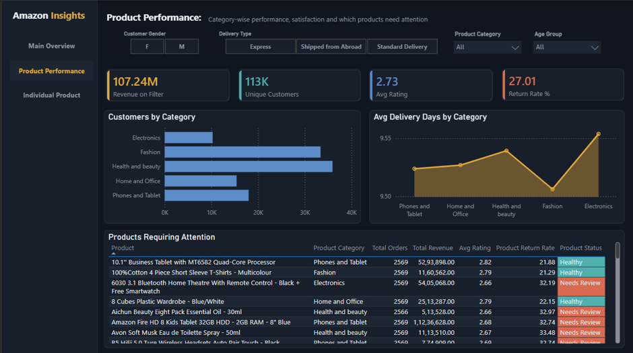
DASHBOARD WALKTHROUGH

Slide 18
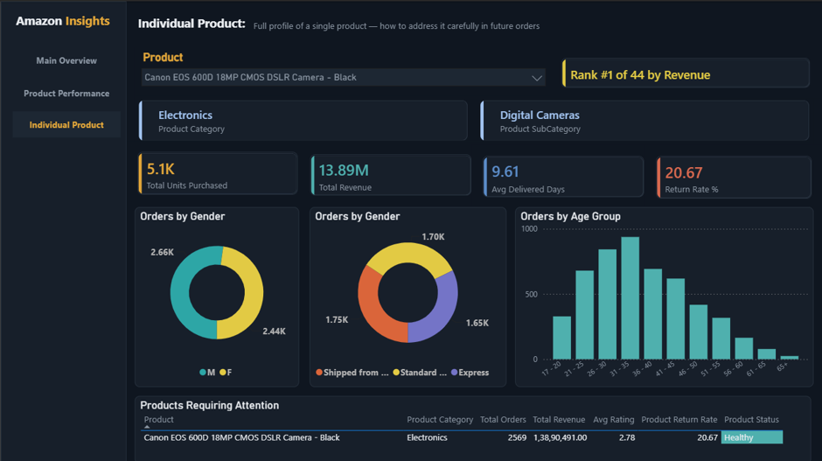
DASHBOARD WALKTHROUGH

Slide 19
KEY RECOMMENDATIONS
  Tiered loyalty program based on spend
  Express delivery as a loyalty perk
  Fix defective-item QC + product descriptions to cut returns
  Bundle low-revenue items with core 5 products
  Target February for promotions

Slide 20
CONCLUSION
The analysis of six years of Amazon data revealed that a small group of high‑value customers and core products drive most revenue. Return rates and delivery type emerged as critical factors shaping customer satisfaction and wait times.
By implementing a four‑tier loyalty program, targeted discounts, and location‑specific recommendations, Amazon can enhance customer experience and retention. The interactive Power BI dashboard consolidates these insights, offering stakeholders a clear, data‑driven path to boost performance.

Slide 21
THANK YOU

